Slide 1


Artificial Intelligence (Machine Learning & Deep Learning)
NAVTTC & Strings Technologies
by Salman Ahmad

Slide 2
Outline Week 8 Day 1
Recurrent Neural Network (RNN)
Learning from Sequences over Time

Slide 3
Why Recurrent Neural Network?
Traditional neural networks assume inputs are independent.
But in many problems (text, speech, time series), order matters.
Example:
“The movie was not good” ≠ “The movie was good not”
RNNs handle sequential data by maintaining memory of previous inputs.

Slide 4
What is an RNN?
A neural network that loops over sequence elements.
Maintains a hidden state that captures information from previous time steps.
Each time step reuses the same weights:
h_{t} = σ⁡ (W_{xh}x_{t}+W_{h}h_{t−1}+ b)
Allows the model to "remember" context from earlier in the sequence.

Slide 5
Recurrent Unit: h_{t} = σ⁡ (W_{xh}x_{t}+W_{hh}h_{t−1}+ b)
Symbol | Meaning
h_{t} | Hidden state at time t. Represents the memory of the RNN after seeing input up to time t. It gets passed to the next time step.
x_{t} | Input at time t. One step in the input sequence (e.g., a word embedding, a time series value).
h_{t−1} | Hidden state from previous time step. Acts as memory — it carries information forward.
W_{xh} | Weight matrix for input. Transforms the current input x_{t} to hidden space.
W_{h} | Weight matrix for hidden state. Transforms the previous hidden state h_{t−1} to influence the current one.
b | Bias vector. Added to shift the activation.
σ | Activation function (usually tanh or ReLU). Introduces non-linearity so the network can learn complex patterns.

Slide 6
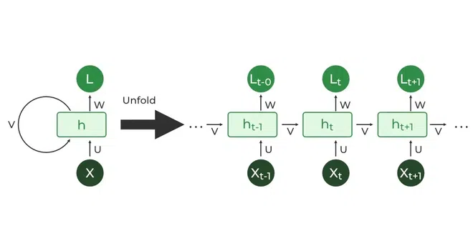
RNN

Slide 7
RNN: Forward Pass
For each time step t:
Takes current input x_{t}​
Combines it with previous hidden state h_{t−1}
Passes it through non-linearity (usually tanh or ReLU)
Produces new hidden state h_{t}​, and possibly output y_{t}

Slide 8
Backpropagation Through Time (BPTT)
To train RNNs, we apply backpropagation across all time steps.
Gradients are computed over unrolled network:
Loss:
loss = sum([loss(y[t], output[t] ) for t in range(1, T)])
This is called Backpropagation Through Time (BPTT)
Allows learning temporal dependencies
But causes vanishing/exploding gradients in long sequences

Slide 9
Vanishing & Exploding Gradients
Problem | Cause | Effect
Vanishing | Repeated multiplication by small derivatives | Gradients disappear, no learning
Exploding | Repeated multiplication by large derivatives | Training becomes unstable
Solutions:
Use LSTM / GRU
Use gradient clipping
Use residual connections (rare in vanilla RNNs)

Slide 10
RNN Use Cases
Domain | Application
NLP | Text classification, sentiment analysis, machine translation
Time Series | Stock prediction, weather modeling
Speech | Speech recognition, synthesis
Healthcare | Patient vital sign prediction

Slide 11
RNN Limitations
Struggles with long-term dependencies
Sequential processing limits parallelism
Training is slow and sometimes unstable
LSTM and GRU were developed to fix these issues

Slide 12
RNN in TF/Keras
from tensorflow.keras.models import Sequential
from tensorflow.keras.layers import Embedding, SimpleRNN, Dense
model = Sequential([
Embedding(input_dim=10000, output_dim=64),
SimpleRNN(128),
Dense(1, activation='sigmoid')
])
Embedding → Converts word IDs into vectors
SimpleRNN → Processes sequence step by step
Dense → Classifies sentiment (e.g., IMDB review)

Slide 13
Summary
Aspect | Detail
Handles sequence | Yes
Maintains memory | Through hidden state
Learns patterns | Short-term well, long-term poorly
Use cases | NLP, time series, speech, etc.
Limitations | Vanishing gradients, slow training

Slide 14

Questions?
"He who asks a question is a fool for a minute; he who does not remains a fool forever." – Confucius

